Slide 1
Black Holes In the Milky Way: Your neighbors that Want to Eat You
Imran Hasan
Yale University

Slide 2
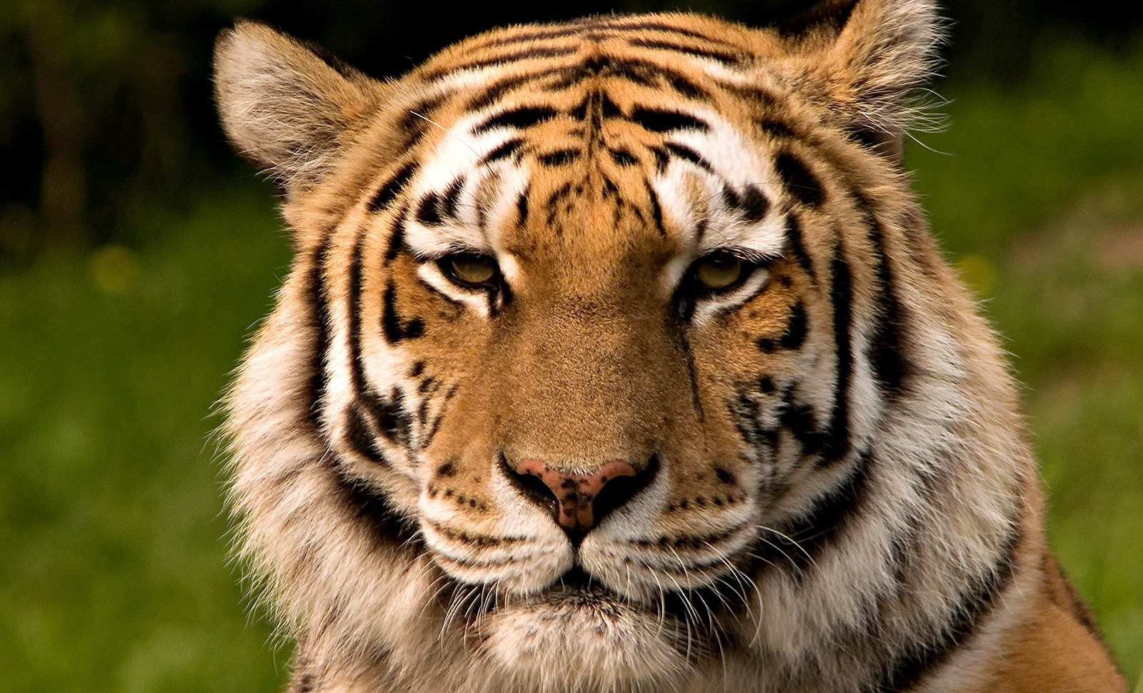

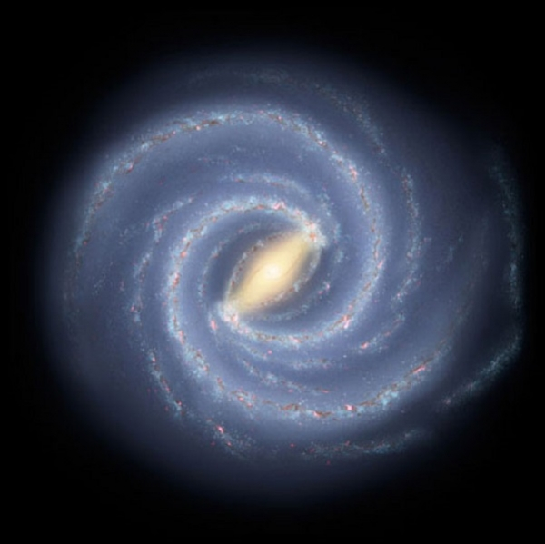
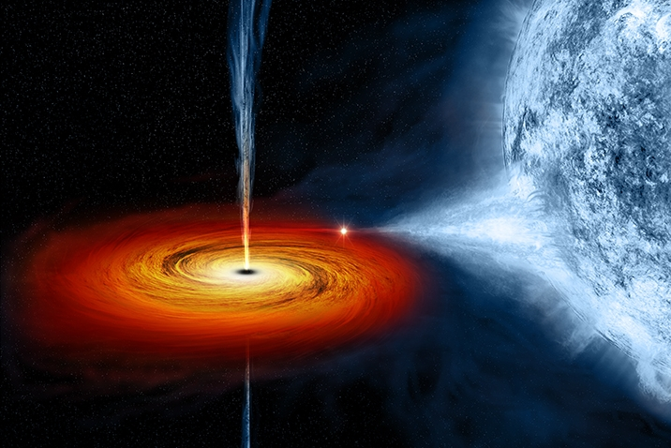
A Family Portrait
Big
Small
Notes:
BH family like cat family. Big cat small cat Even though you can distinguish them by their size, they have an awful lot of things in common.
The same is true for black holes. There are very large black holes, weighing millions of times as much as the sun, and smaller black holes which weigh as much as a couple of suns. Although they differ in mass, they have a lot in common. lets start with the heaviest of them all, and work our way down.

Slide 3
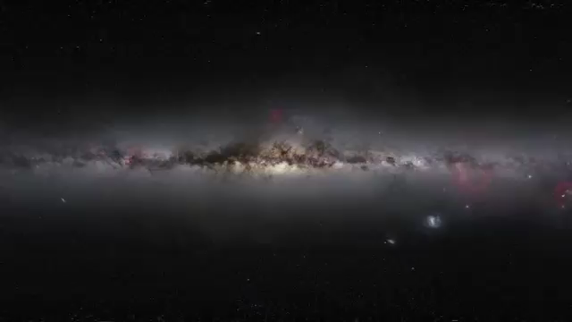
A closer look at the Galactic Center
Notes:
This is the milky way galaxy as seen from earth, the galaxy that we call home. To visit smbh we have to go to the center. The galaxy is a big place, peel away layers and try to get to the center.
So where is it?
Being a scientist, an astronomer, is a lot like being a detective. Detectives solve crimes, even with out directly seeing them transpire. A detective arrives at the scene of a crime after it occurred, tallies the evidence, makes a list of plausibly explanations, maybe gathers some more evidence, and narrows down the list of possibilities until only one remains.
So lets gather some more evidence

Slide 4
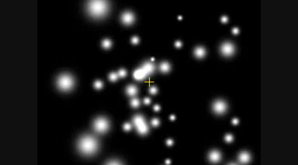
Sgr A*
What is now considered to be the best empirical evidence that super-massive black holes do really exist.
The stellar orbits in the galactic center show that the central mass concentration of four million solar masses must be a black hole, beyond any reasonable doubt (2009, Gillessen et al.)
Notes:
These dots are stars dancing across the sky. They were carefully watched and their positions were painstakingly measured over the course of 10 years, and from there their orbits were carefully calculated.
Indeed, using some high powered 17th century math and physics, you can infer that there is a silent unseen monster imposing these orbits on the stars in this movie.
the same physics that keeps the earth orbiting the sun, and the moon orbiting the earth, is at work guiding these stars around this point.
using what we know about orbital dynamics, we can calculate the mass that *must* be at this point to explain the orbits we observed, and it comes in tipping the scale at a few millions of times the mass of the sun!

Slide 5
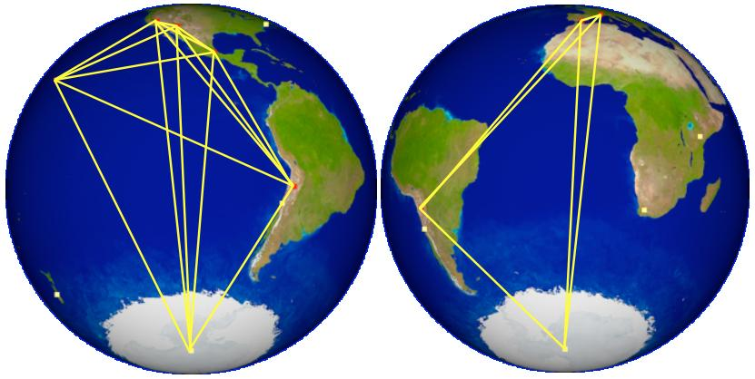
Event Horizon Telescope
Notes:
Will our view ever get better? There is an upcoming telescope that is designed to peer into the galactic center, and lift the veil on this mysterious patch of the night sky
The Event Horizon Telescope is a network of other telescopes (dots) work together (lines) Longer line = better ability to distinguish detail.

Slide 6
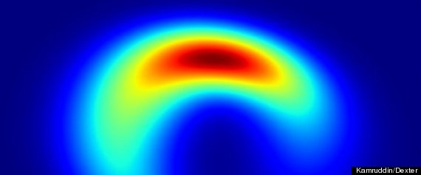
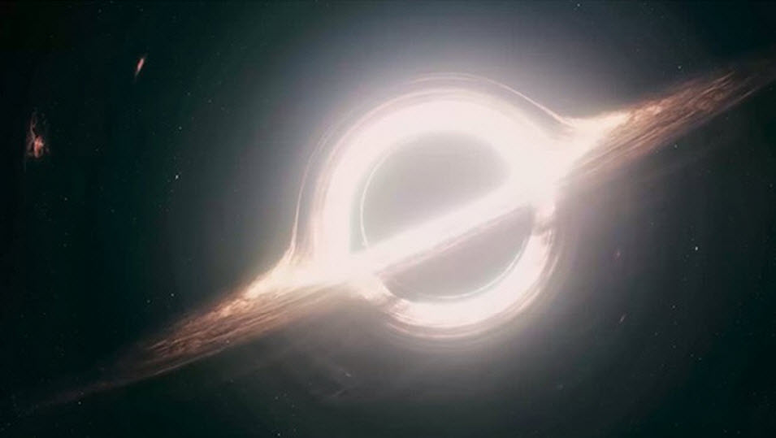
The view(s) to come
Event Horizon telescope
Hollywood
Simulated image from EHT
In fall of material into Sgr A*

Slide 7
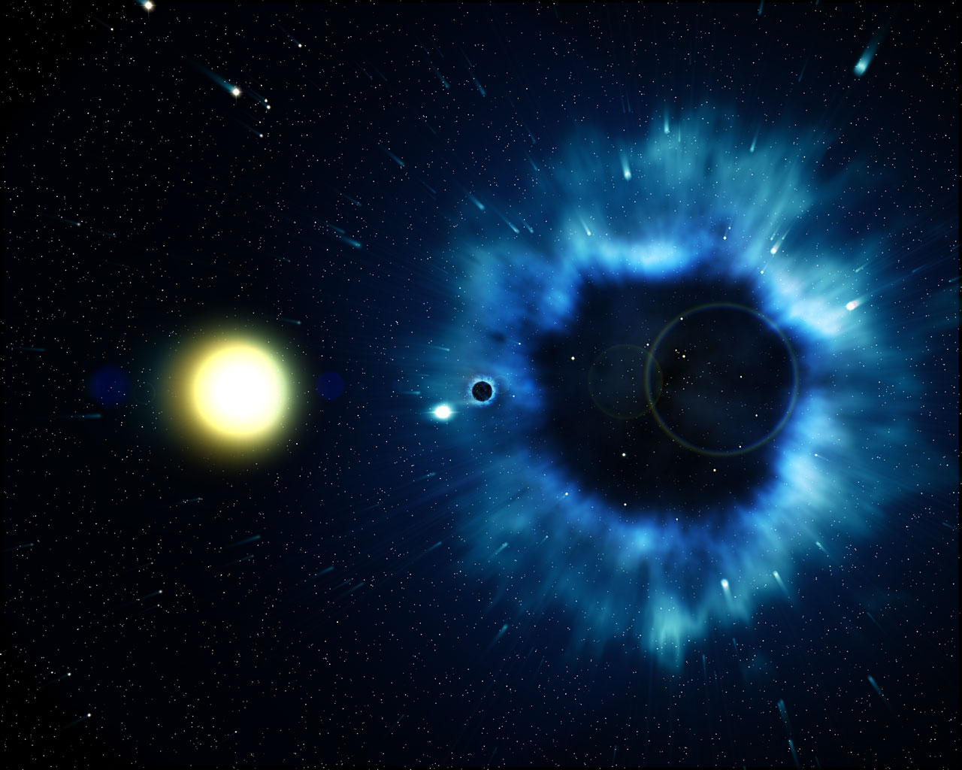
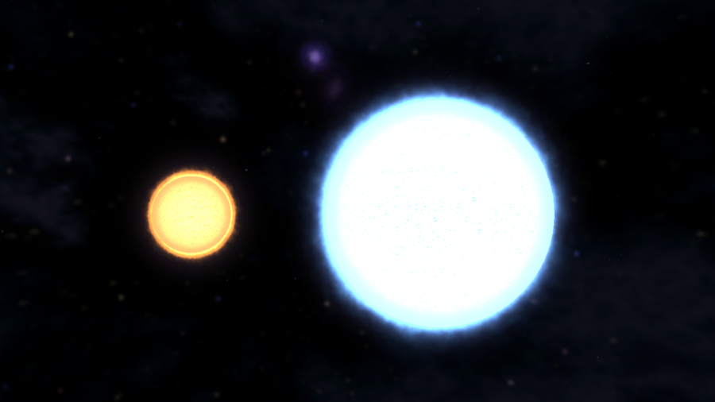
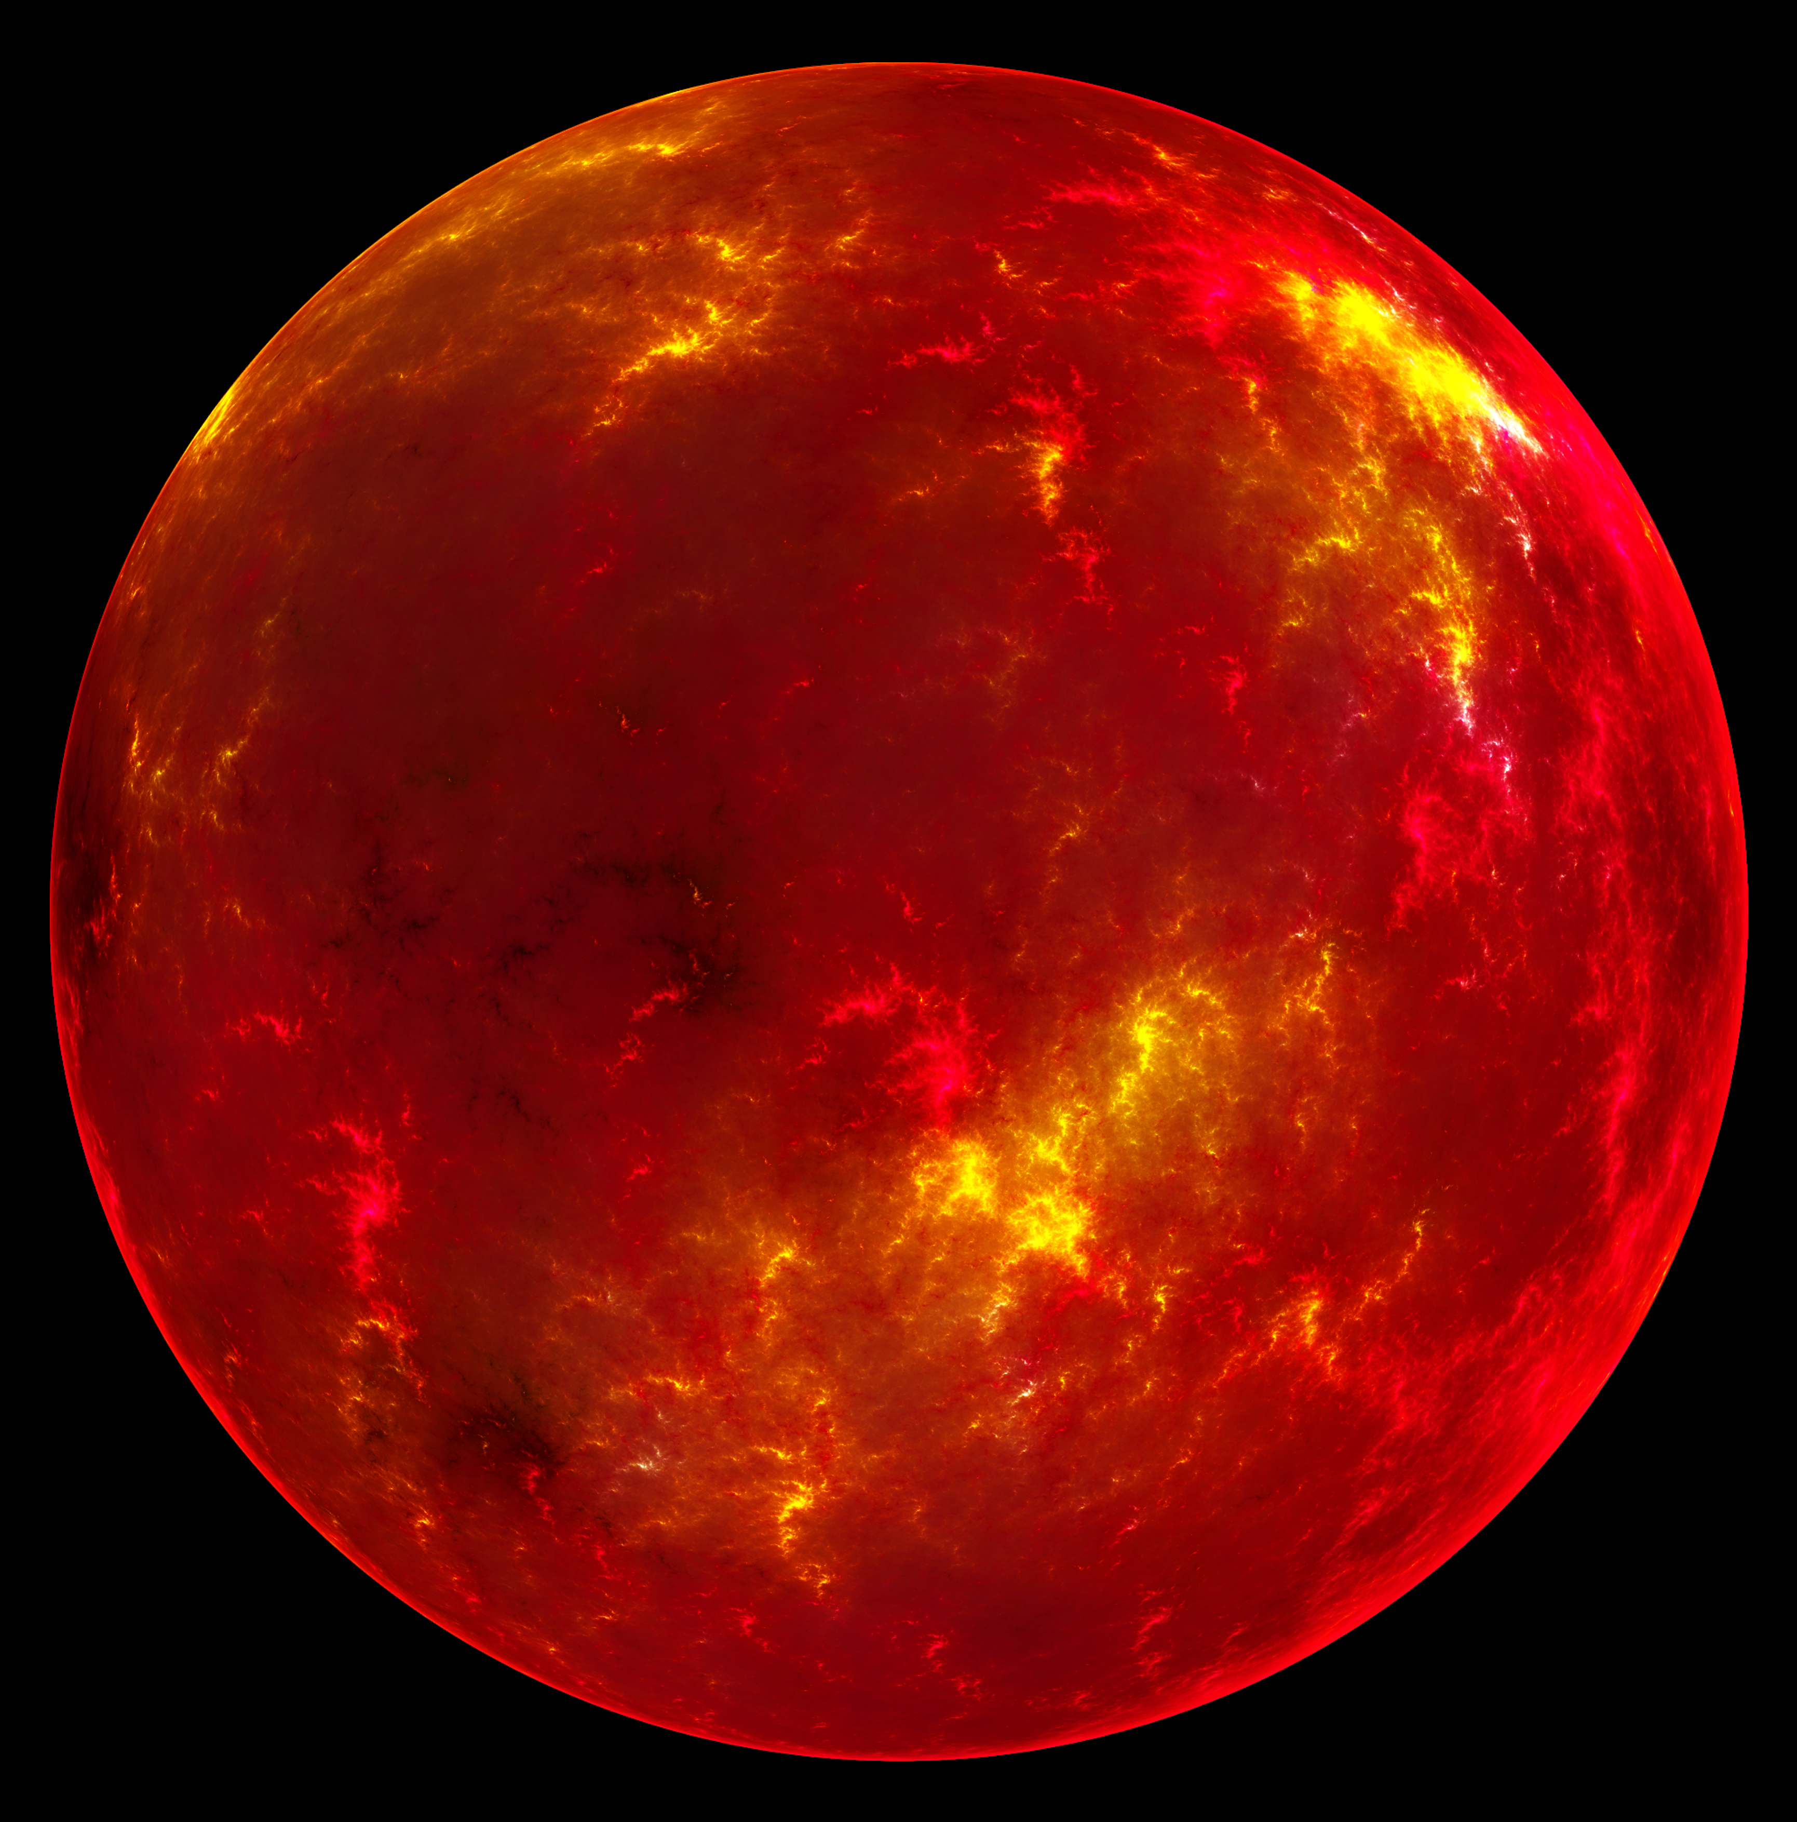
Stellar Companions
Notes:
Before we directly talk abt stellar mass bh, tell their origin story=it has consequences to how we observe them know they exist
Start off 2 stars.prob born together, coming from same stellar nursary.
One dies super nova, blows off outer layers, leaves behid dense core: black hole
Other evolves and becomes big and puffy as it gets old (like people)
As the red giant expands, its surface comes dangerously close to the bh, and the bh actually starts to strip material off of it.

Slide 8
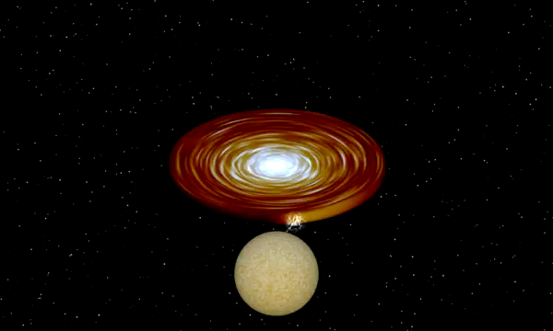
An Endless Waltz
Notes:
Material is syphoned off of the puffy star by the black hole, and swirls around bh in a disk, eventually falls on bh. Process called acretion-ubiquitous in astronomy.
Familiar terrestrial process: water going down a drain.
Process is special bc it is how we know bh exists, we observe the signitues of this process
Violent events, emit high energy light: stay tuned for steph
Stellar fratracide

Slide 9

Undead Star
Notes:
Lets recap XRB
Born, live a life, die, come back from dead, start eating friends
ZOMBIE STAR!!!!

Slide 10
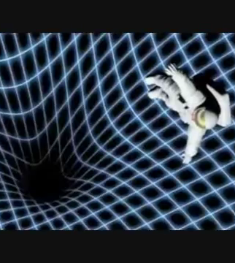
Black Hole Eats You!
Gravity at your Legs is MUCH stronger than at your Head
Like being drawn and quartered
Stretchy -> Spaghetti

Slide 11
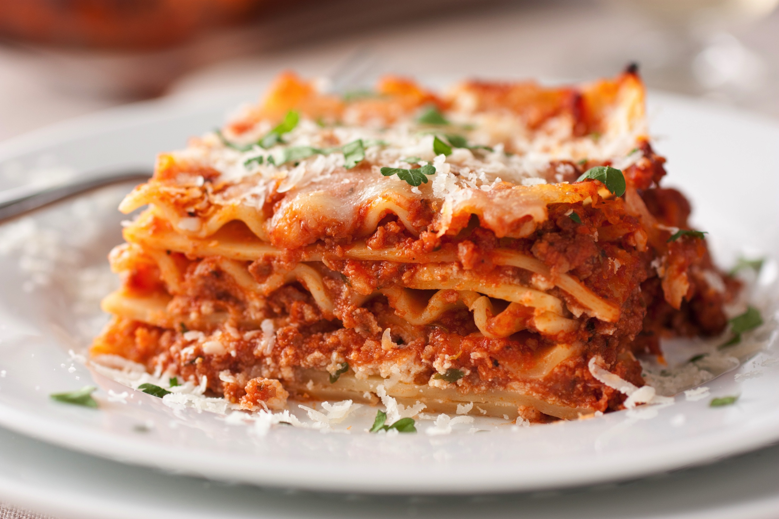
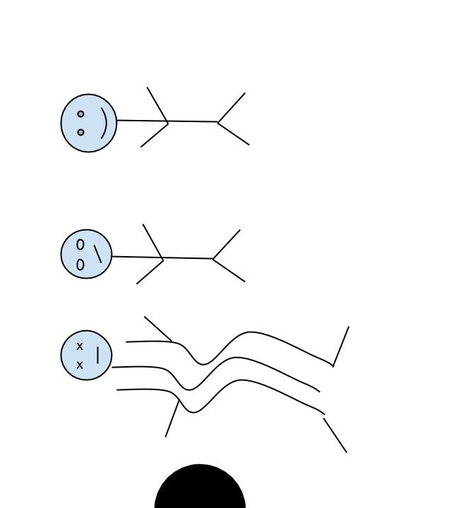
A different-but also tasty-approach
Go in laying down instead of feet first
You will make it further
You will still die ☹
Instead you will be pulled apart width wise, you will become wide flat slices

Slide 12
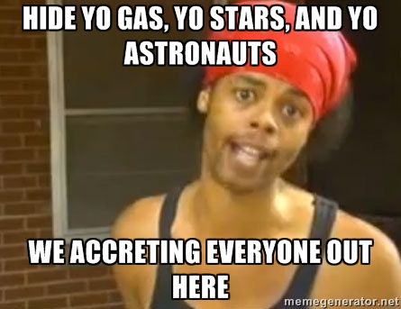
Conclusion: A Warning from The Heavens

